Slide 1
CSC 250: Foundations of Computer Science I
Fall 2023 - Lecture 2
Amitabha Dey
Department of Computer Science
University of North Carolina at Greensboro

Slide 2
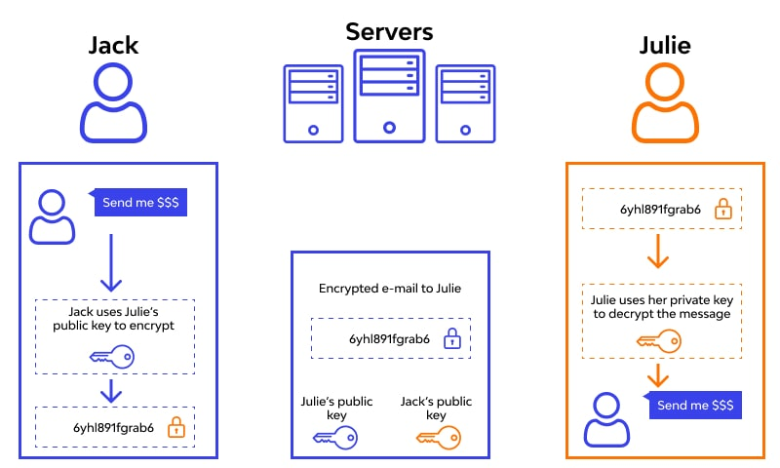
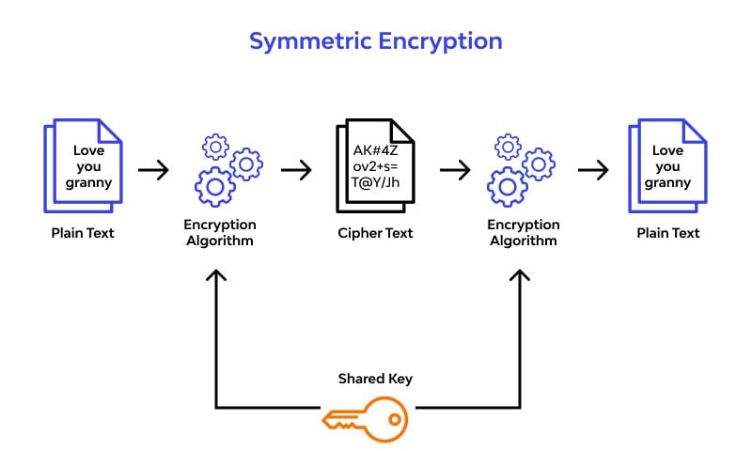
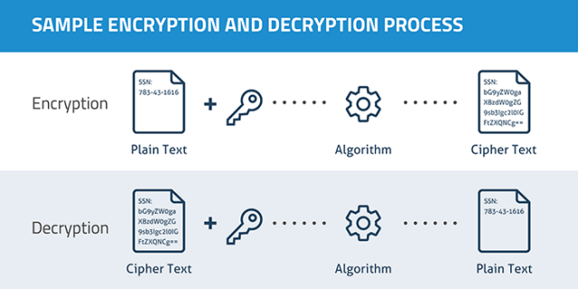
Encryption
Encryption is the practice of scrambling information in a way that only someone with a corresponding key can unscramble and read it. Encryption is a two-way function. When you encrypt something, you’re doing so with the intention of decrypting it later.
To encrypt data you use something called a cipher, which is an algorithm – a series of well-defined steps that can be followed procedurally – to encrypt and decrypt information. The algorithm can also be called the encryption key.
Image credit - https://mediawiki.middlebury.edu/
Image credit - https://www.wallarm.com/

Slide 3

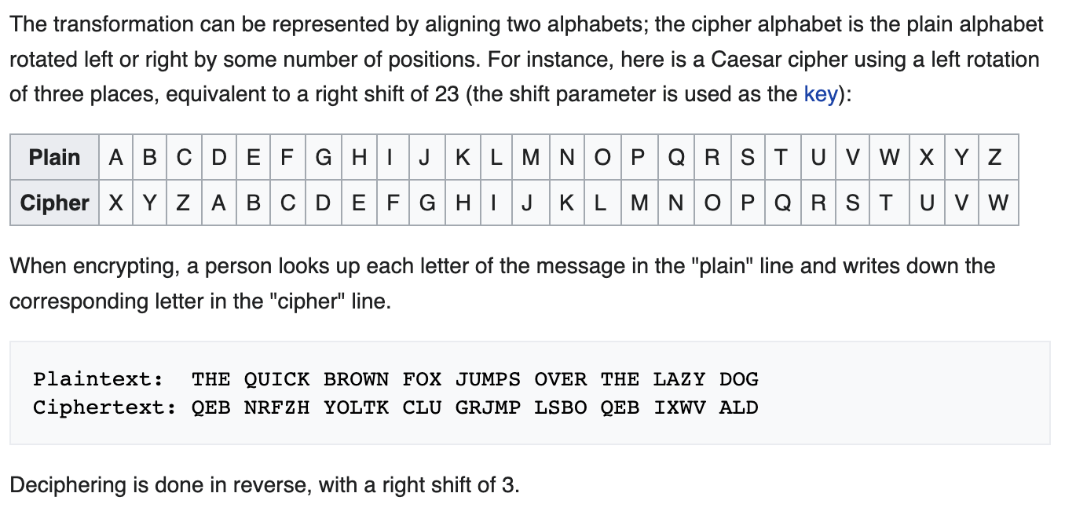
Caesar Cipher
In cryptography, a Caesar cipher, also known as Caesar's cipher, the shift cipher, Caesar's code or Caesar shift, is one of the simplest and most widely known encryption techniques. It is a type of substitution cipher in which each letter in the plaintext is replaced by a letter some fixed number of positions down the alphabet. For example, with a left shift of 3, D would be replaced by A, E would become B, and so on. The method is named after Julius Caesar, who used it in his private correspondence.
Image credit - https://historylearning.com/
Image credit - https://en.wikipedia.org/

Slide 4
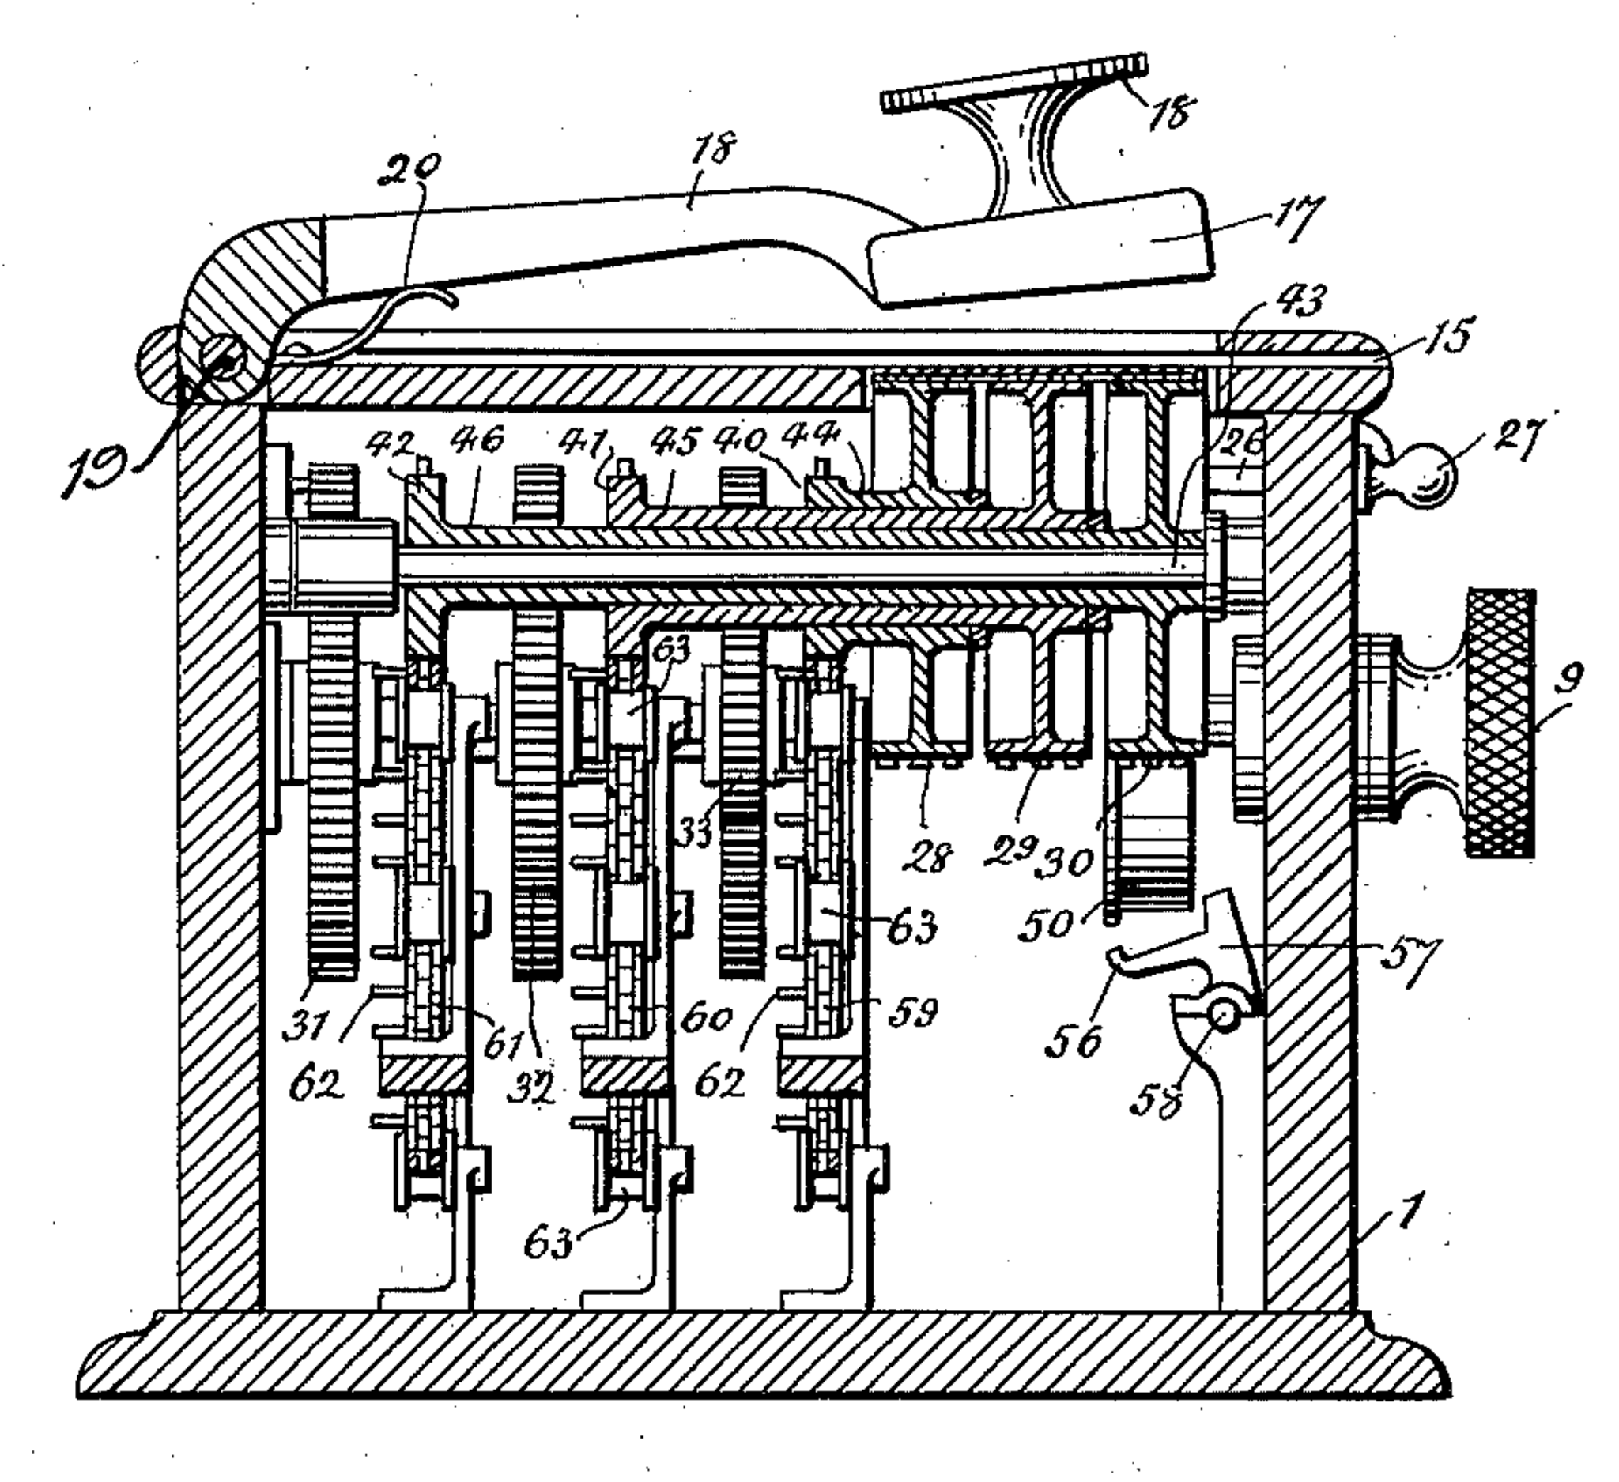
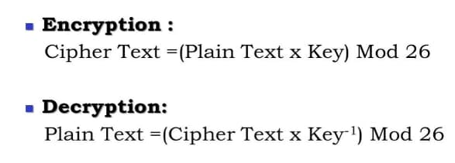
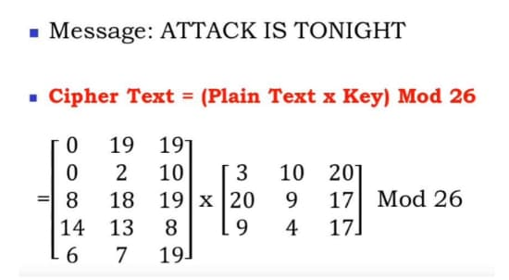
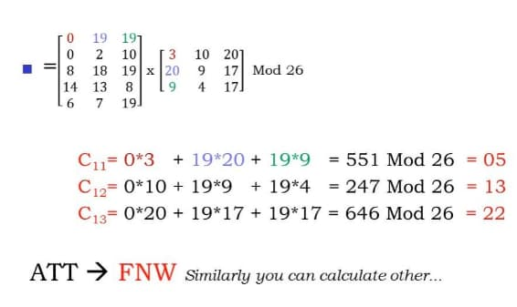
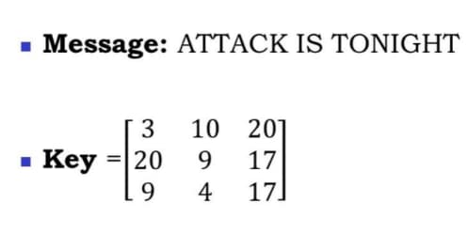
Hill Cipher
Hill cipher is a polygraphic substitution cipher based on linear algebra.Each letter is represented by a number modulo 26. Often the simple scheme A = 0, B = 1, …, Z = 25 is used, but this is not an essential feature of the cipher. To encrypt a message, each block of n letters (considered as an n-component vector) is multiplied by an invertible n × n matrix, against modulus 26. To decrypt the message, each block is multiplied by the inverse of the matrix used for encryption.
The matrix used for encryption is the cipher key, and it should be chosen randomly from the set of invertible n × n matrices (modulo 26).
Image credit - https://en.wikipedia.org/
Image credit - https://www.cybrary.it/

Slide 5
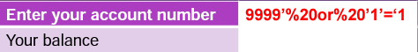

SQL Injection
Results in:
res = select CBalance from Balances where Acct=‘3215’
But what if the user enters something like this
SQL is “Structured Query Language”. It is a standardized language for accessing databases. Every programming language implements SQL functionality in its own way.
Examples of SQL statements -
select name from employee where ssn=‘123456789’
select name, ssn, dob from employee where ssn=‘123456789’ and id=‘31042’
select code,namefrom products where code =‘536’ union select code,name from sales where code > ‘500’
Assume that the select statement implemented is:
res = select CBalance from Balances where Acct=‘$acct’
$acct is the variable containing the account number input by the user (PHP style naming ) This is a typical usage of a select statement to look up a value
%20 is the placeholder for a space
Since ‘1’=‘1’ is always true, the select statement will return all records
res will contain, depending on the language
every record
the first record
the last record
The attacker will have valuable information for further attacks, such as issuing a transaction against the account number discovered
Image credit - CSCI 476, Montana State University

Slide 6
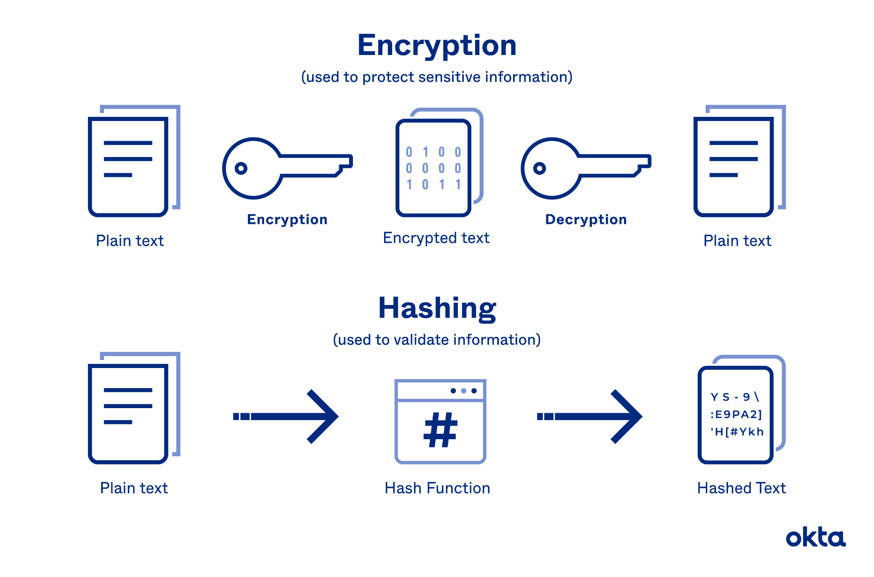
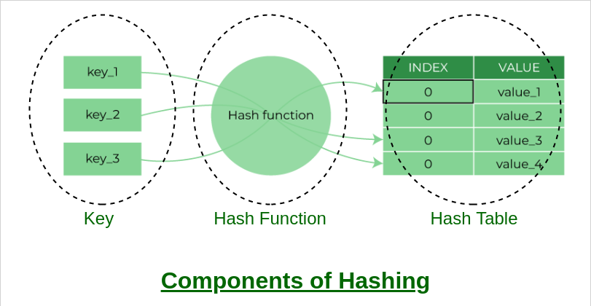
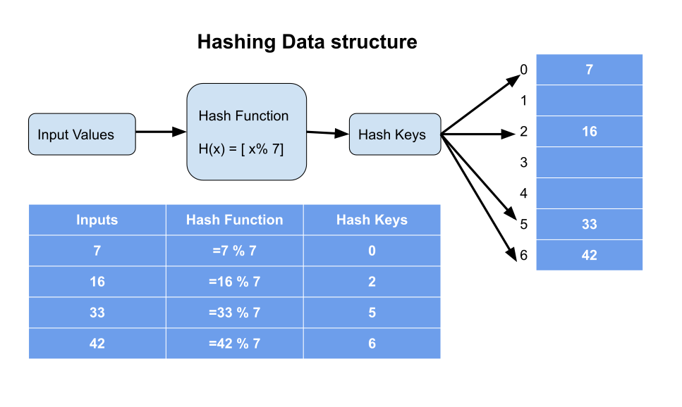
Hashing
Hashing is the practice of using an algorithm to map data of any size to a fixed length. This is called a hash value. Whereas encryption is a two-way function, hashing is a one-way function. While it’s technically possible to reverse-hash something, the computing power required makes it unfeasible. Hashing is one-way.
Image credit - https://www.okta.com/
Image credit - https://www.geeksforgeeks.org/
Image credit - https://technicalsand.com/

Slide 7
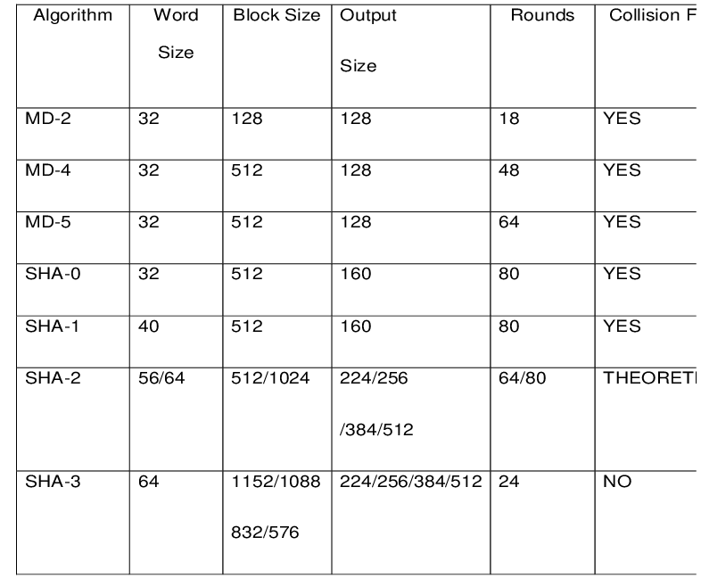
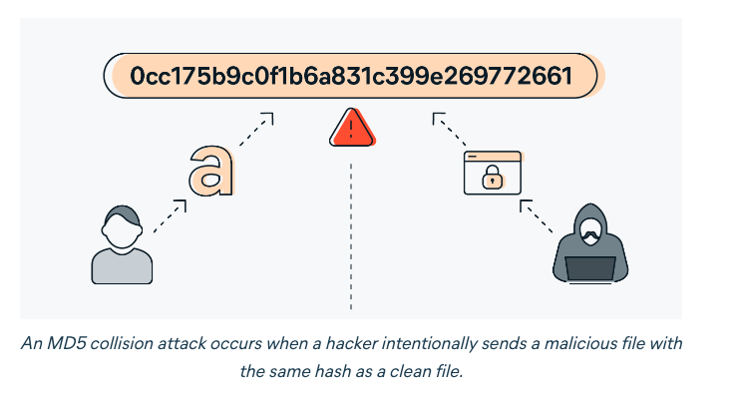
Popular Hashing Algorithms
MD-5. The MD5 message-digest algorithm is a widely used hash function producing a 128-bit hash value. Very weak, not safe.
SHA. The Secure Hash Algorithms are a family of cryptographic hash functions. More secure.
MD5 Hash Generator
https://www.md5hashgenerator.com/
Image credit - Security of Password Hashing in Cloud - Scientific Figure on ResearchGate. Available from: https://www.researchgate.net/figure/Comparison-between-different-hash-algorithms-19_fig2_331380160 [accessed 16 Jan, 2023]
Image credit - https://www.avast.com/

Slide 8
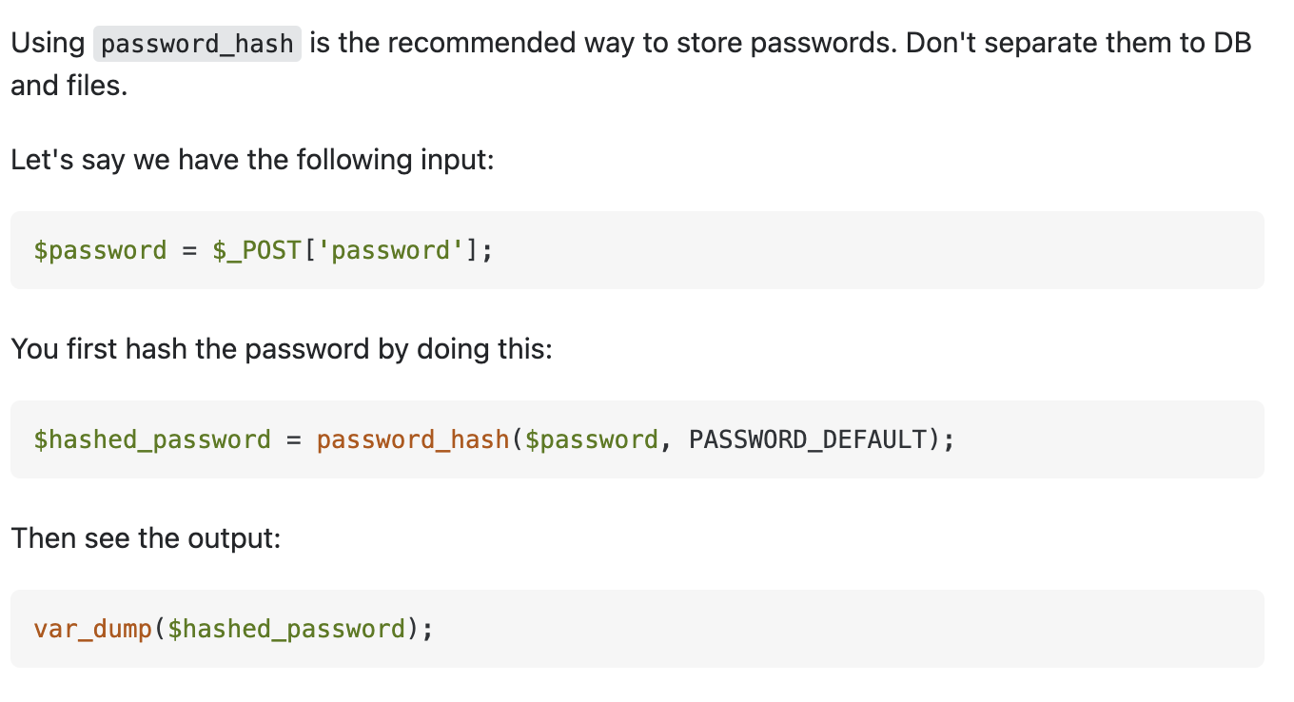
Properties of a Good Hash Function
Main characteristics of a good hash function:
Output is deterministic. The same input produces the same output.
Non-reversible - it should be very difficult to go backwards from the hash to all of potential inputs.
One-way function y = h(x). Given y, it is very hard to find x.
The hash function generates very different hash values for similar strings.
The hash is collision free, meaning it is not feasible that two different messages would result in the same hash value
Easy to compute - Given message m, hash function h(m) is easy to compute

Slide 9
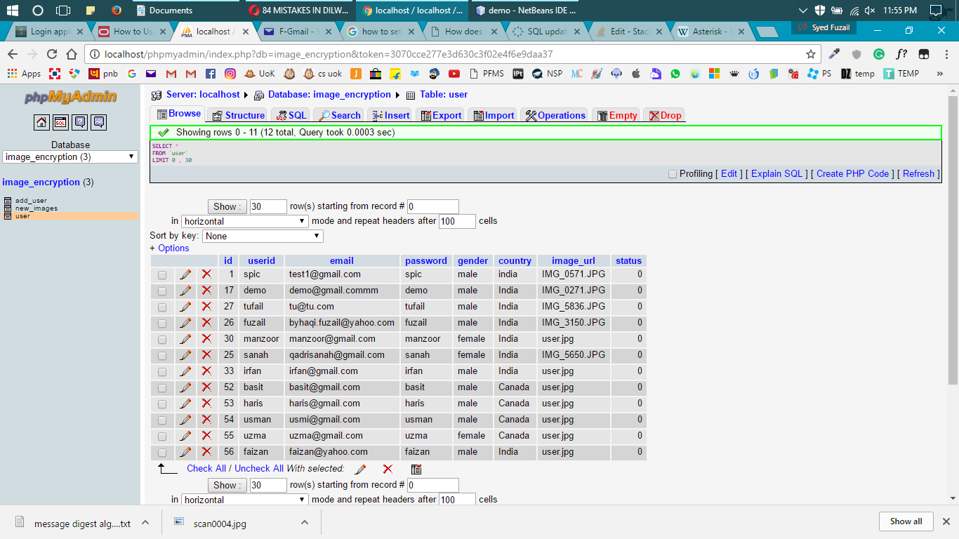
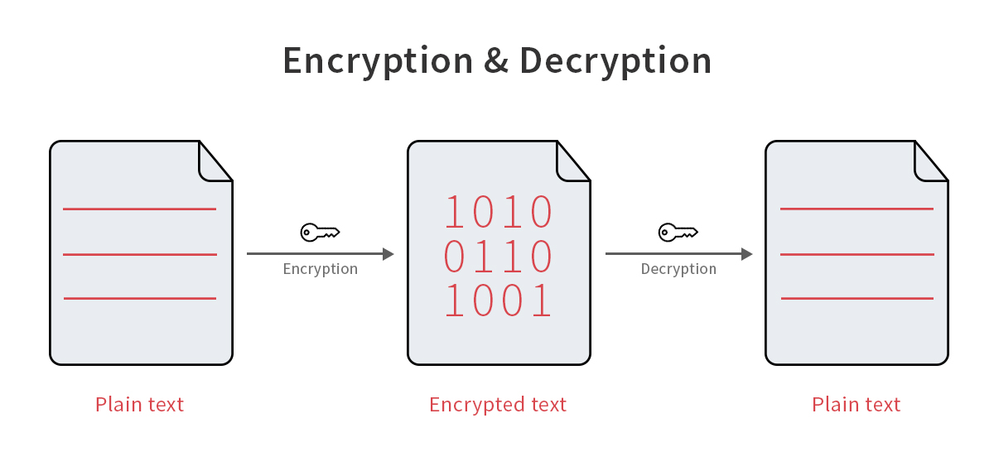

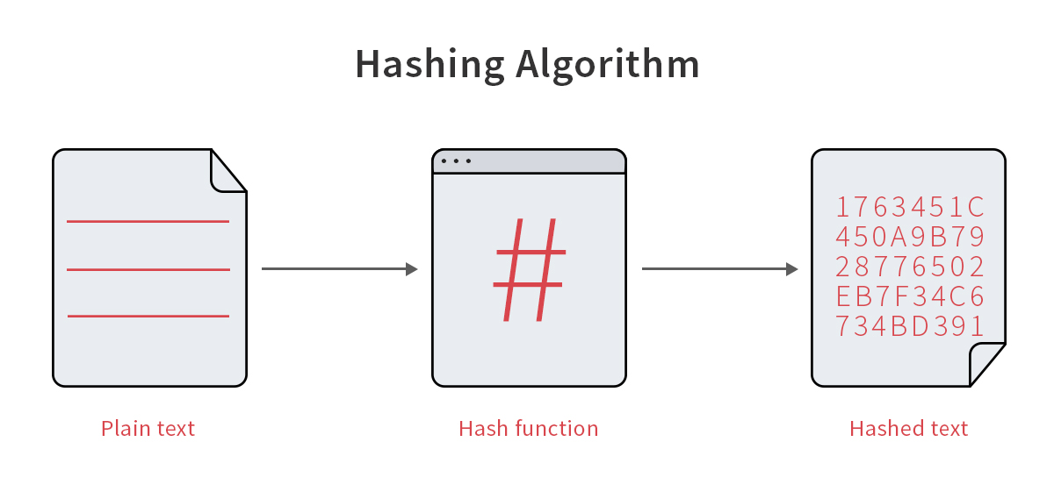
How to Not Store Passwords
Storing user passwords in the database as it is in plain text.
Using an encryption method
Using a simple hash function
Image credit - https://stackoverflow.com/
A Rainbow Table is a set of precomputed passwords and their corresponding hash values that can be used to find out what plaintext password matches a particular hash
Image credit - https://blog.elcomsoft.com/

Slide 10
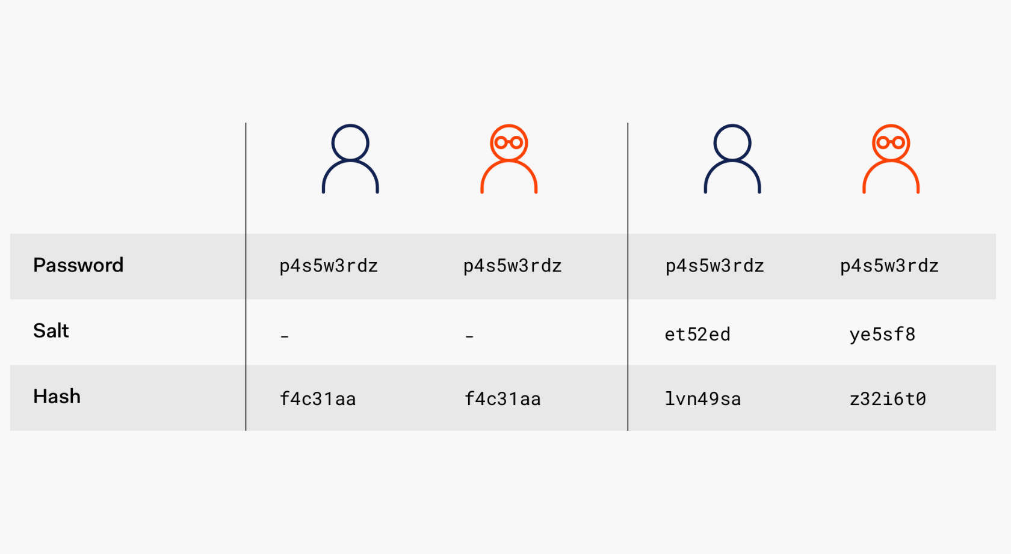
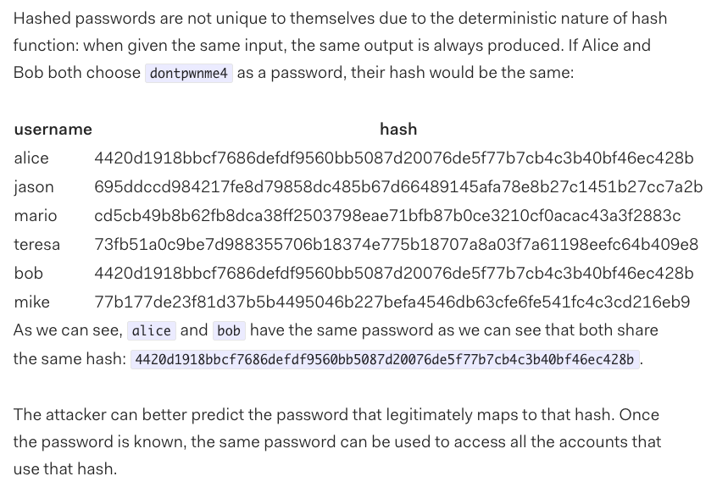
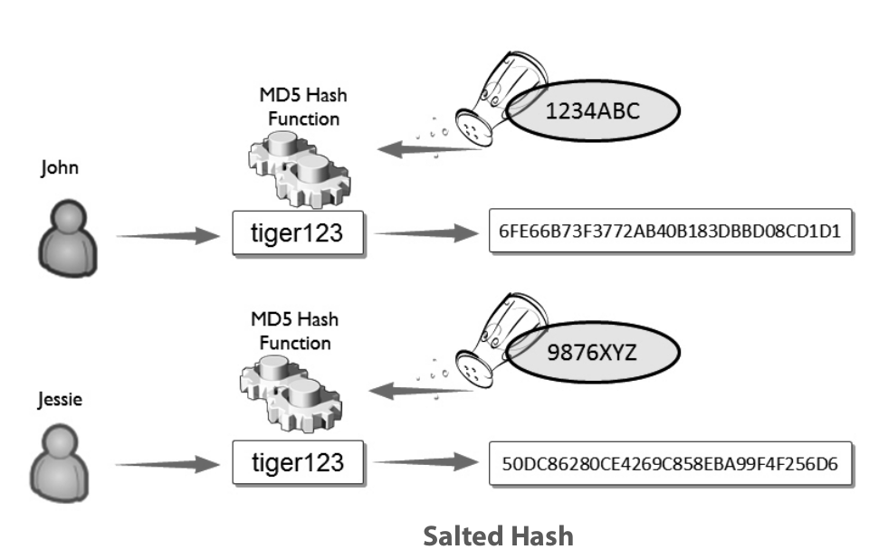
Salted Secure Hash Function
A salt is added to the hashing process to force their uniqueness, increase their complexity without increasing user requirements, and to mitigate password attacks like hash tables
Image credit - https://auth0.com/
Image credit - https://auth0.com/
Image credit - https://forum.huawei.com/

Slide 11
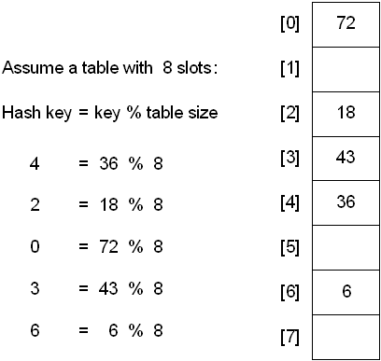
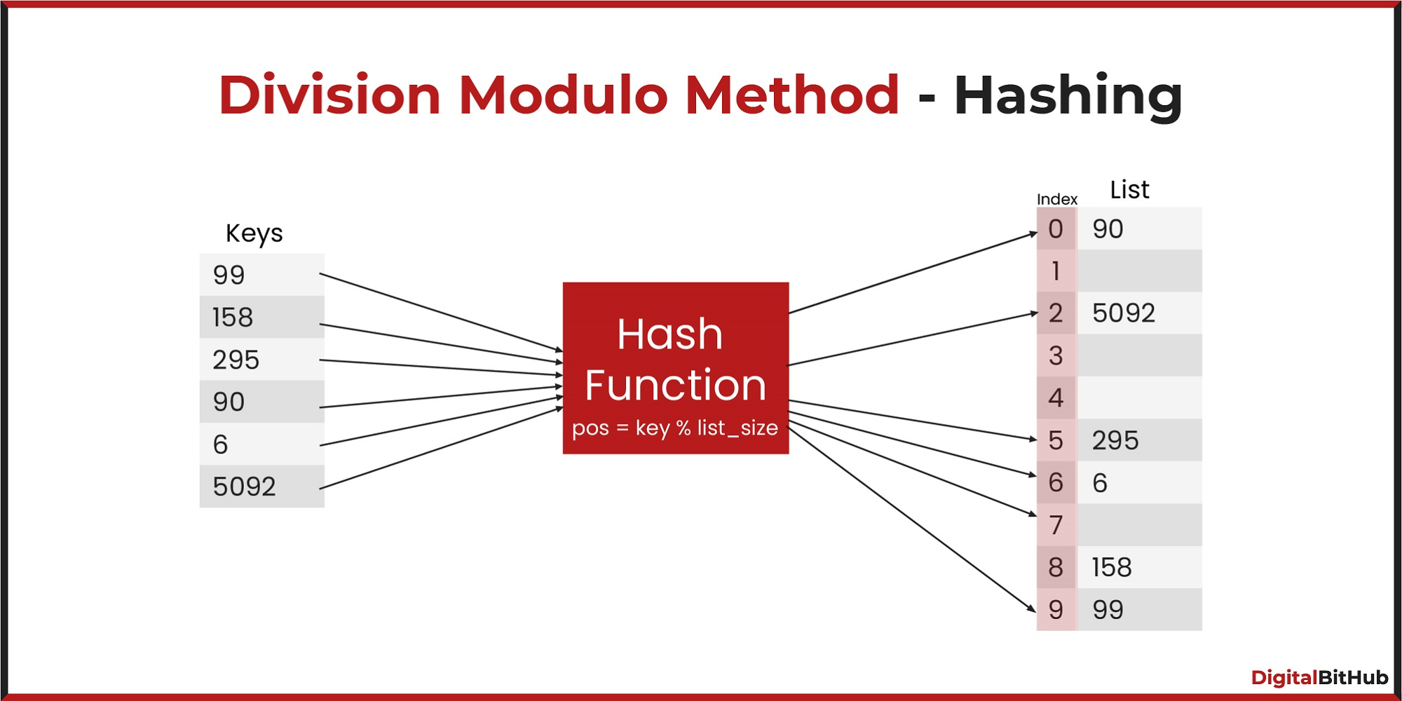
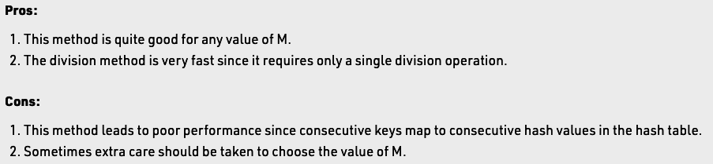
Division Method
The division method is generally a reasonable strategy, unless the key happens to have some undesirable properties. For example, if the table size is 10 and all of the keys end in zero.
In this case, the choice of hash function and table size needs to be carefully considered. The best table sizes are prime numbers.
One problem though is that keys are not always numeric. In fact, it's common for them to be strings.
One possible solution: add up the ASCII values of the characters in the string to get a numeric value and then perform the division method.
Image credit - https://faculty.cs.niu.edu/
Image credit - https://www.digitalbithub.com/
Image credit - https://www.geeksforgeeks.org/

Slide 12
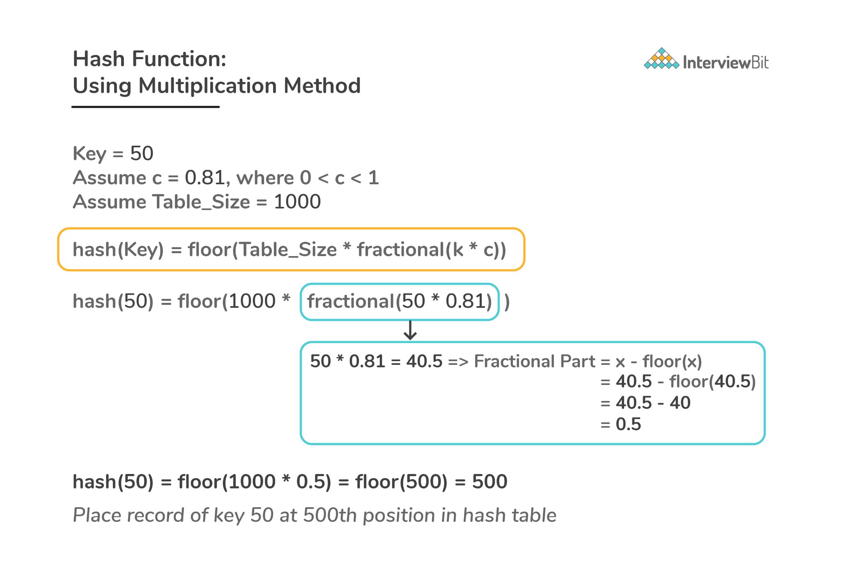
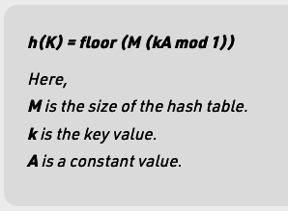
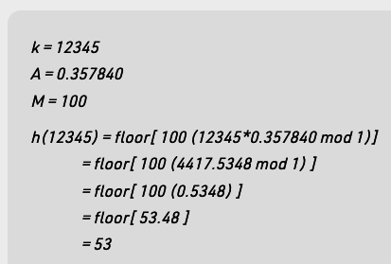
Multiplication Method
Pros:
The advantage of the multiplication method is that it can work with any value between 0 and 1, although there are some values that tend to give better results than the rest.
Cons:
The multiplication method is generally suitable when the table size is the power of two, then the whole process of computing the index by the key using multiplication hashing is very fast.
Image credit - https://www.interviewbit.com/
Image credit - https://www.geeksforgeeks.org/

Slide 13
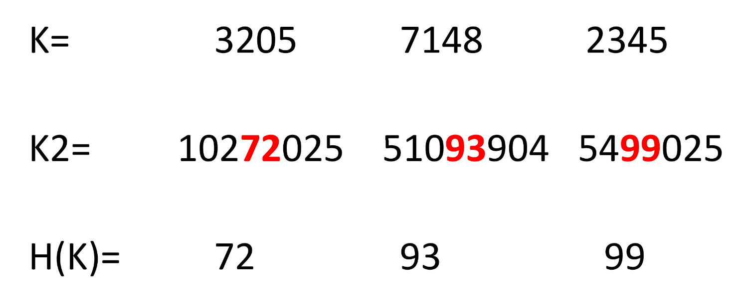
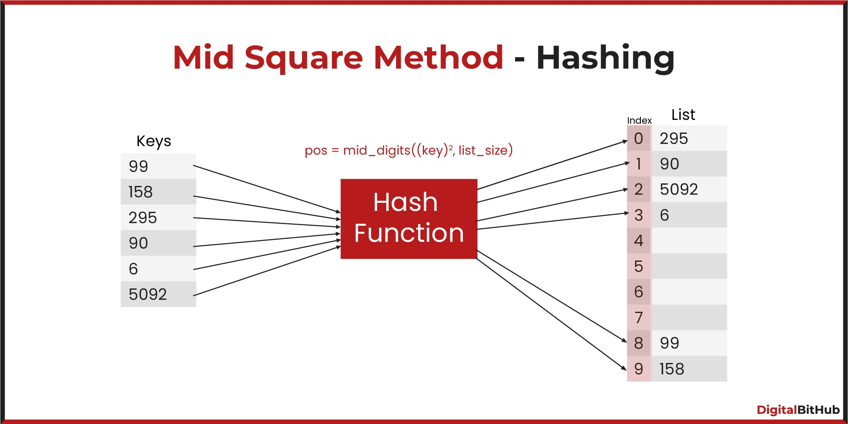
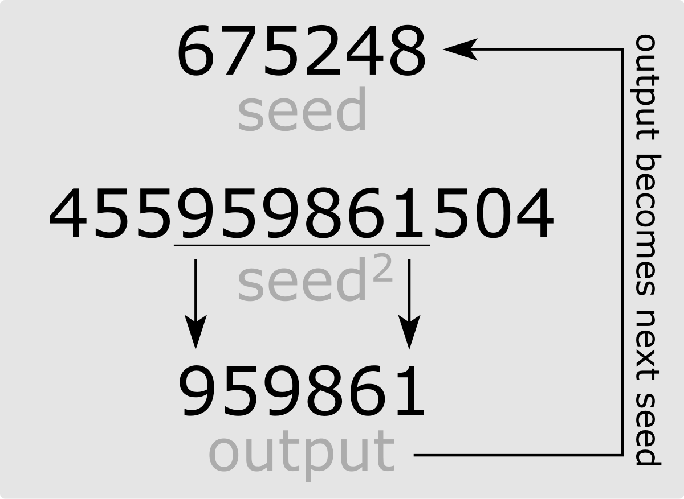
Mid Square Method
Square the value of the key k i.e. k²
Extract the middle r digits as the hash value.
Suppose the size of the Hash Table (m) = 10 (0 - 9) maximum digits required for the index is 1
Element (x) = 12 ⇒ x2 = 144
Mid 1 digit of 144 is 4, so the element x=12 will be stored at the index=4 in the hash table with the size of 10 slots.
Image credit - https://www.learnpick.in/
Image credit - https://en.wikipedia.org/
Image credit - https://www.digitalbithub.com/

Slide 14
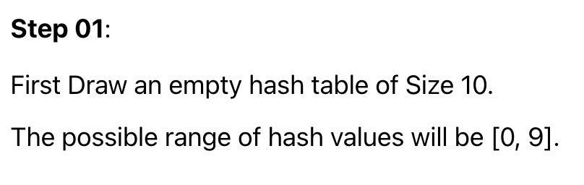
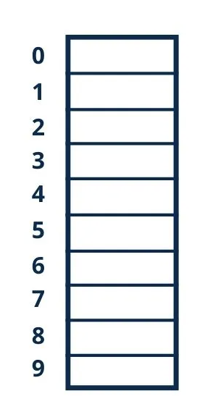
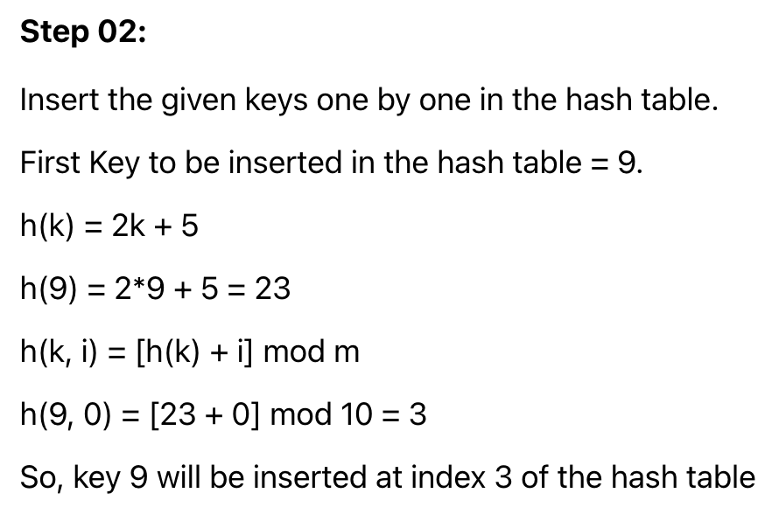
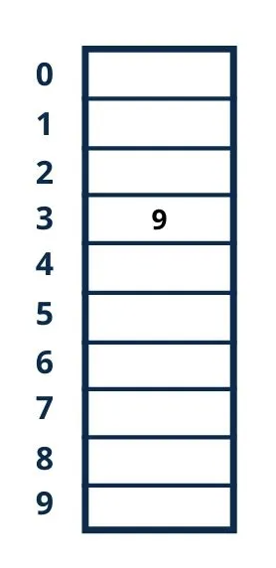
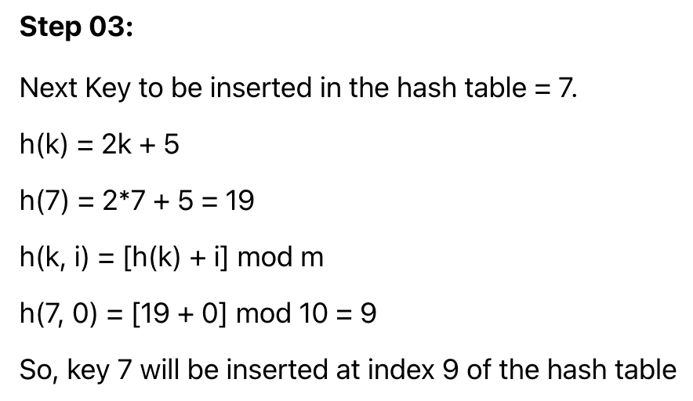
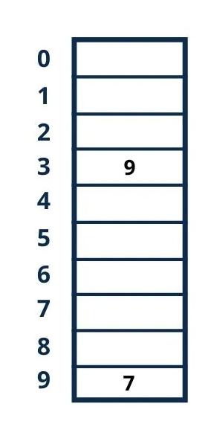
Resolving Collision using Linear Probing
We use the following hash function to resolve the collision:
h(k, i) = [h(k) + i] mod m
Where,
k = key
m = size of the hash table
h(k) = hash function
i = the probe number that varies from 0 to m–1
Example
Insert the following sequence of keys in the hash table
{9, 7, 11, 13, 12, 8}
Use linear probing technique for collision resolution
h(k, i) = [h(k) + i] mod m
h(k) = 2k + 5
m=10

Slide 15
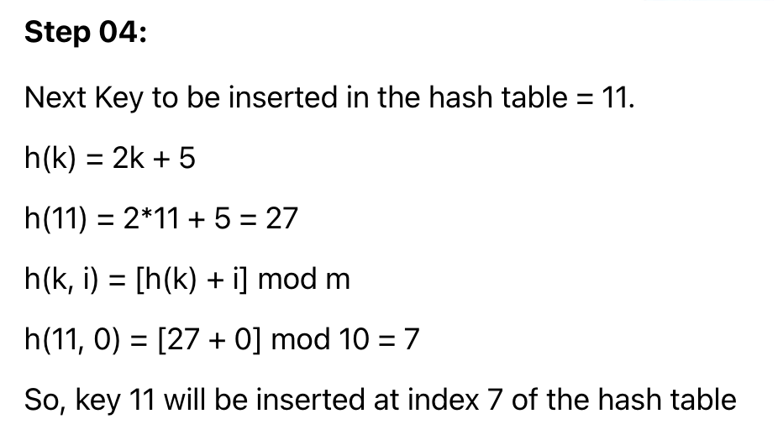
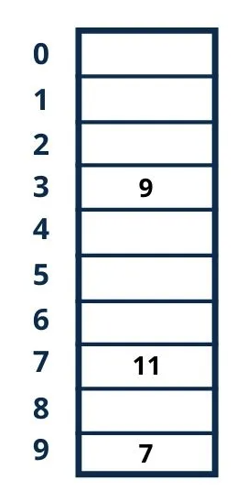
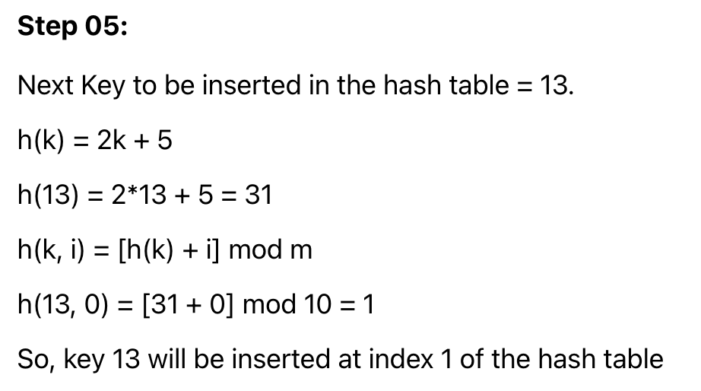
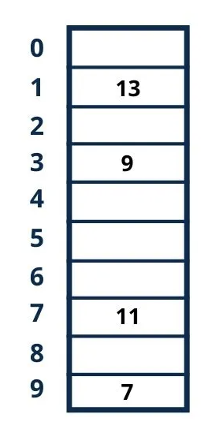
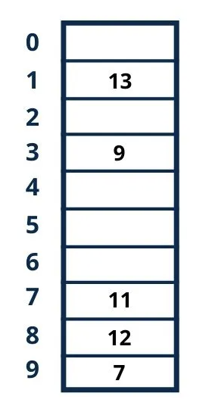
Step 06:
Next key to be inserted in the hash table = 12.
h(k) = 2k + 5
h(12) = 2*12 + 5 = 29
h(k, i) = [h(k) + i] mod m
h(12, 0) = [29 + 0] mod 10 = 9
Here Collision has occurred because index 9 is already filled.
Now we will increase i by 1.
h(12, 1) = [29 + 1] mod 10 = 0
So, key 12 will be inserted at index 0 of the hash table.
Image credit - https://quescol.com

